Slide 1
Lecture 19 - Linear Discriminant Analysis
DS 4400: Machine Learning and Data Mining 1

Slide 2
Today
1 Today
Batch Projection
PCA Review
LDA vs. PCA
5 LDA

Slide 3
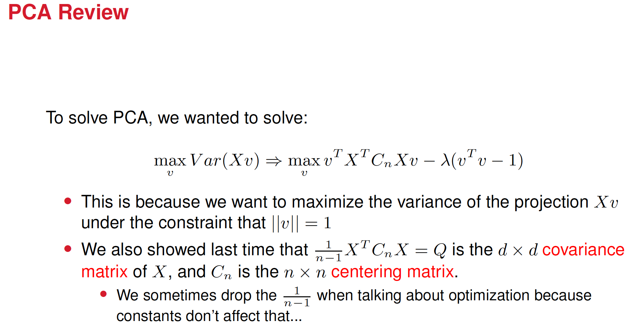

Slide 4
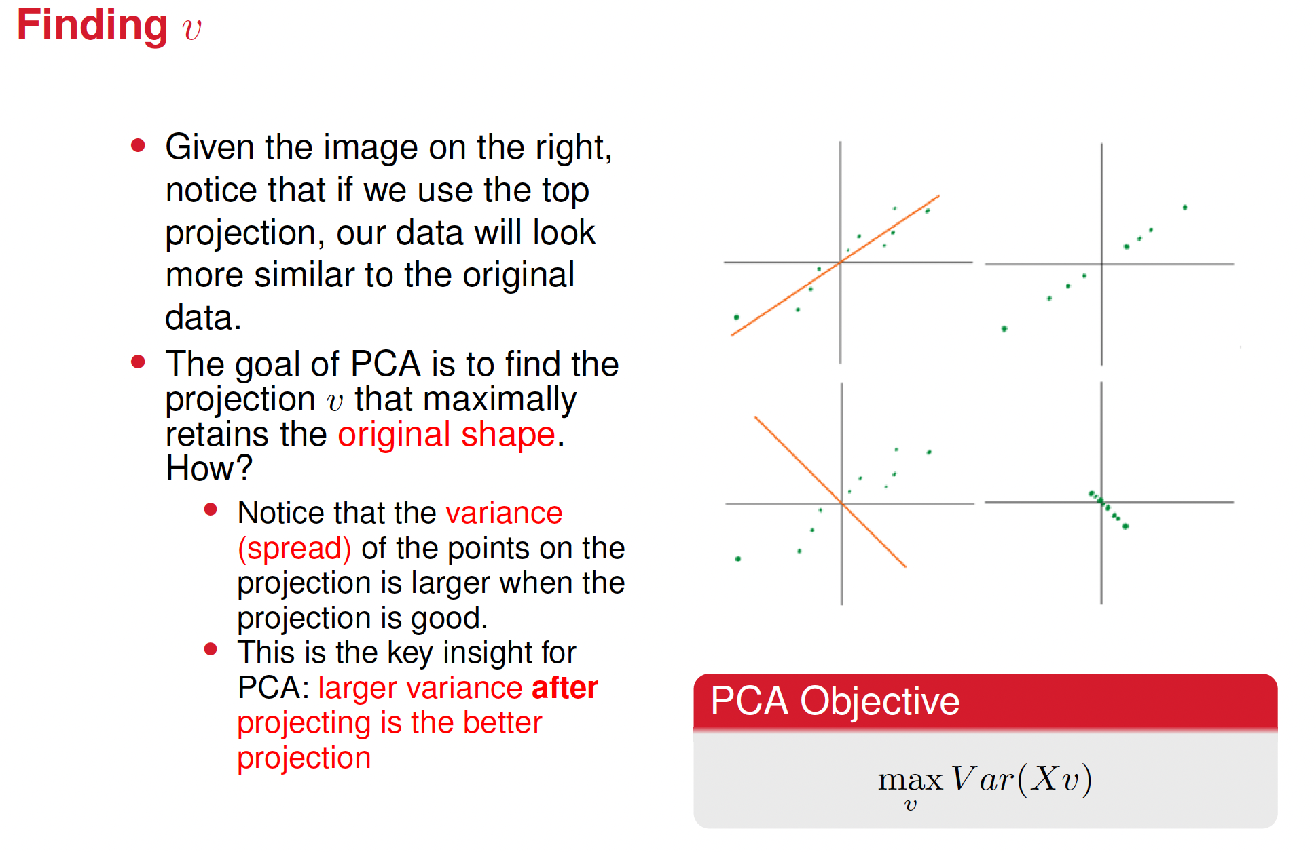

Slide 5
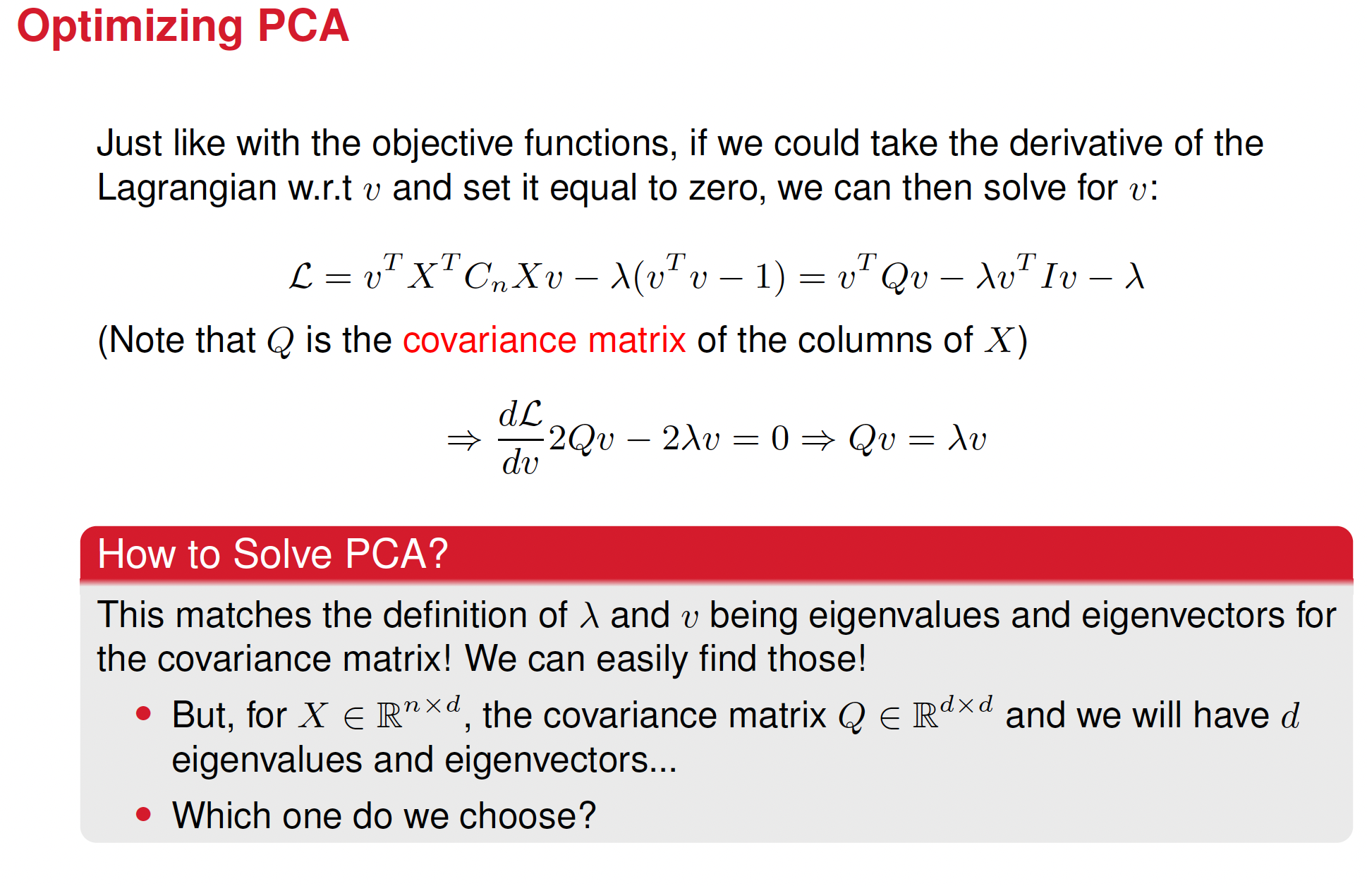

Slide 6
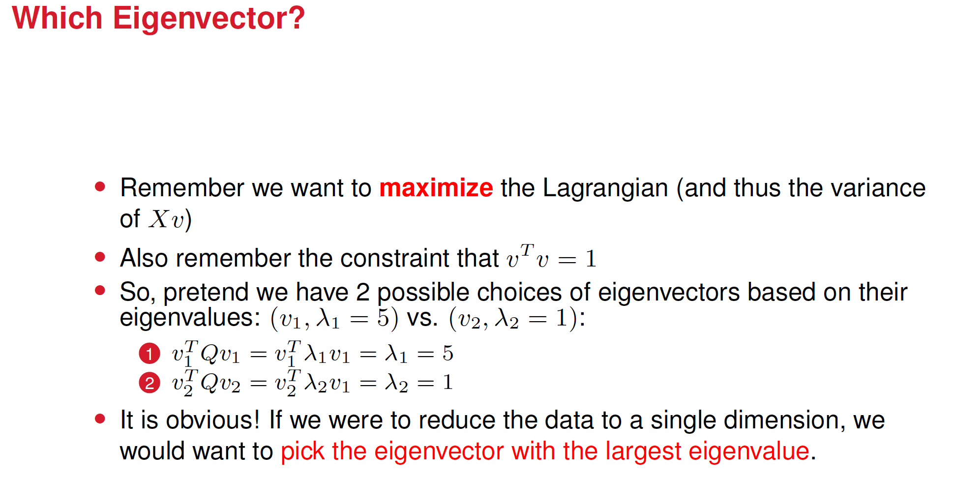

Slide 7
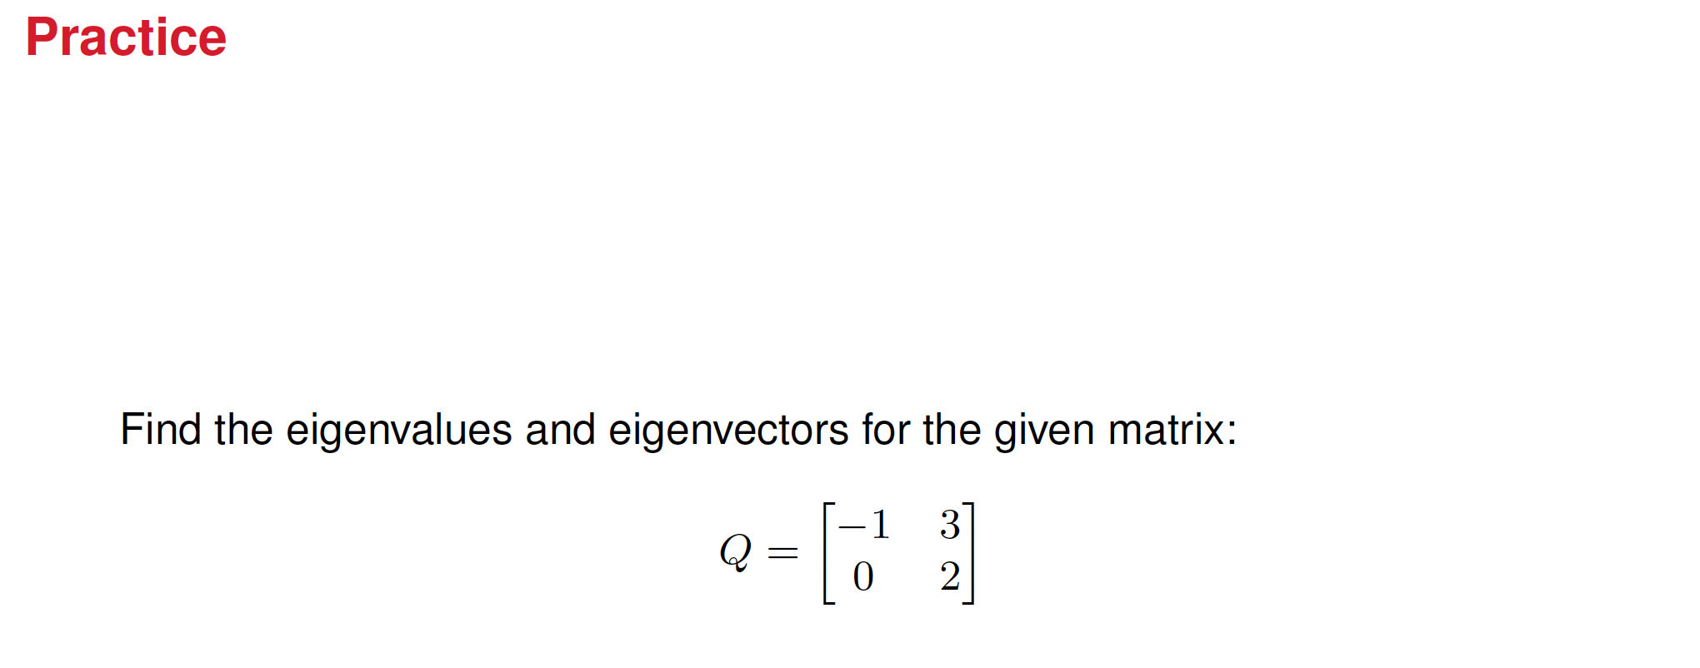












Reviewing an example from last class

Slide 8






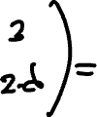







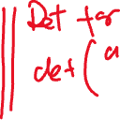












Solution

Slide 9








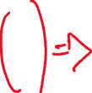














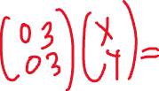


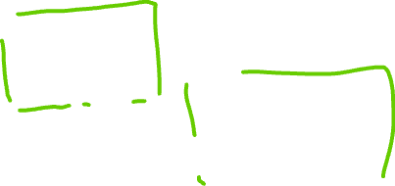




Slide 10
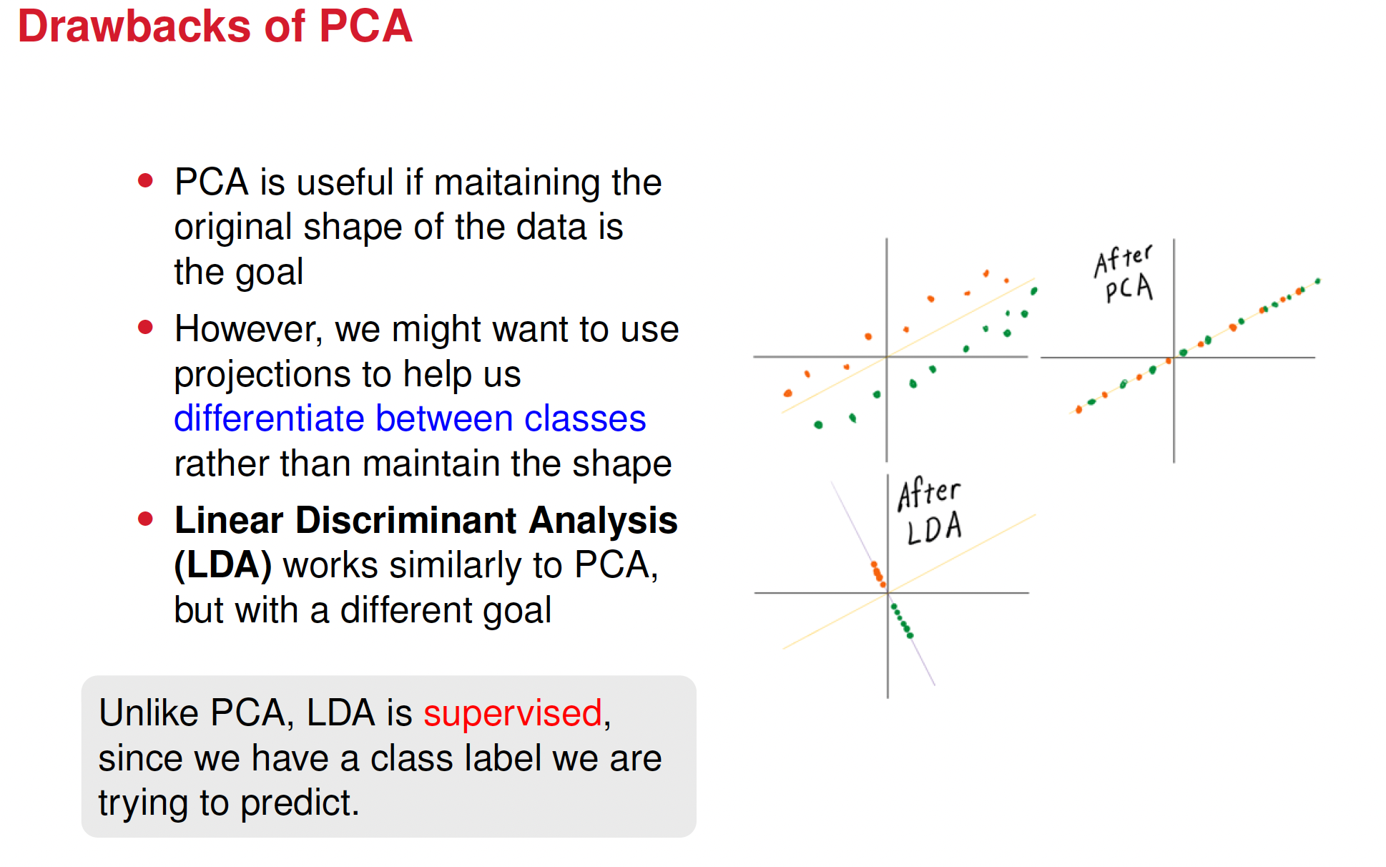

Slide 11
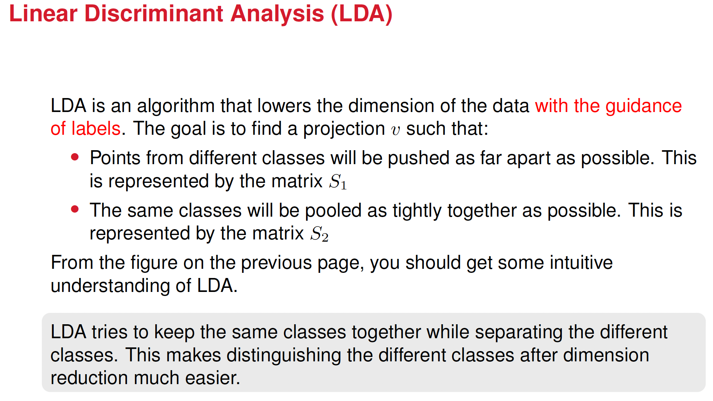

Slide 12
LDA deals with two matrices
S1 matrix: essentially a variance between classes that measures how far apart the means of different classes are (inter-class variance).
S2 matrix: essentially a variance within the same class that measures how much the data points within each class deviate from their class mean (intra-class variance).
The goal of LDA is maximizing S1 while minimizing S2.

Slide 13










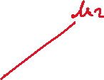












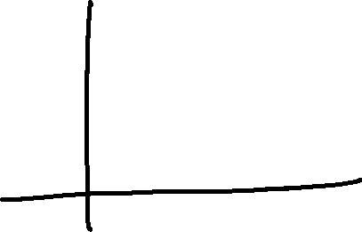
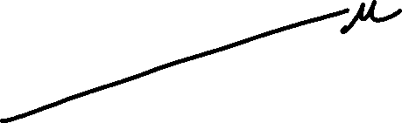









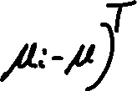
S1 matrix
Recall the formula for the variance

Slide 14






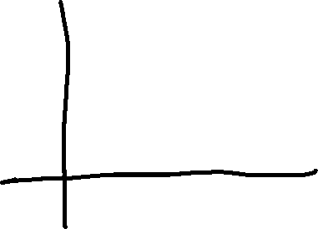




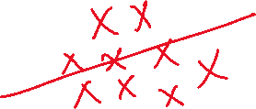







S2 matrix
Recall the formula for the variance

Slide 15










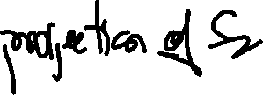









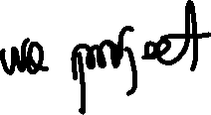




















Slide 16
The entire purpose of Linear Discriminant Analysis (LDA) is
to perform dimensionality reduction in a way that:
Preserves class separability: The projected data points from different classes remain as separated as they were in the original space.
Reduces dimensions: It maps high-dimensional data to a lower-dimensional subspace without losing the essential structure that distinguishes the classes.

Slide 17
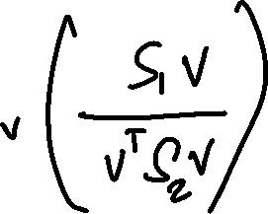


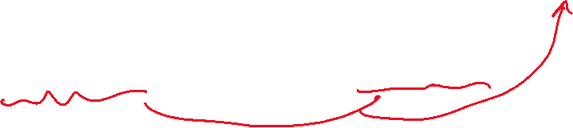








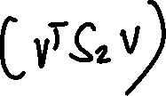

We want a direction $v$ where between-class scatter is large while within-class scatter is small.
We want $v^{T}S_{1}v$ to be large relative to $v^{T}S_{2}v$. The natural way to do this is to maximize the ration
The solution vector v is the optimal projection direction to achieve class separation.

Slide 18
Example with speed
Goal: Go far while using little time.
Two objectives:
• Maximize distance
• Minimize time
Natural combined measure: speed = distance / time
So do this: max (distance/time).
In our case max (vTS1v/vTS2v)

Slide 19
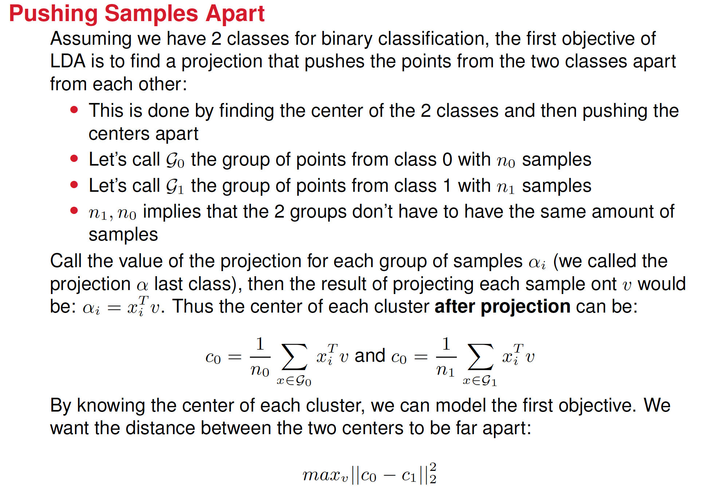
First Objective

Slide 20
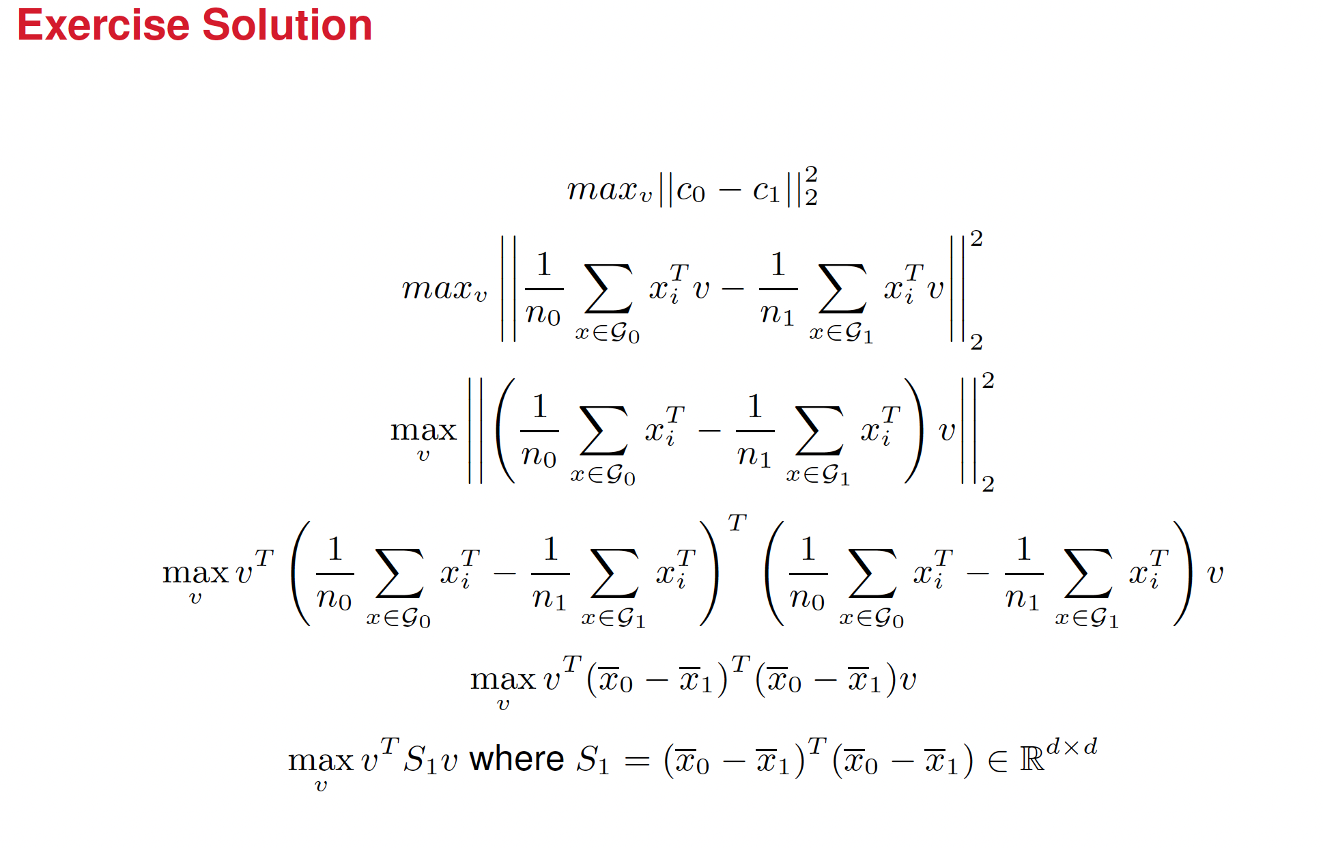
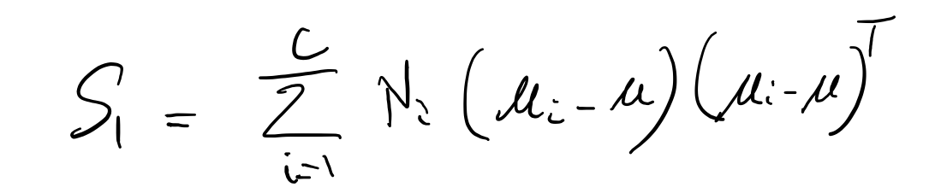



First Objective

Slide 21
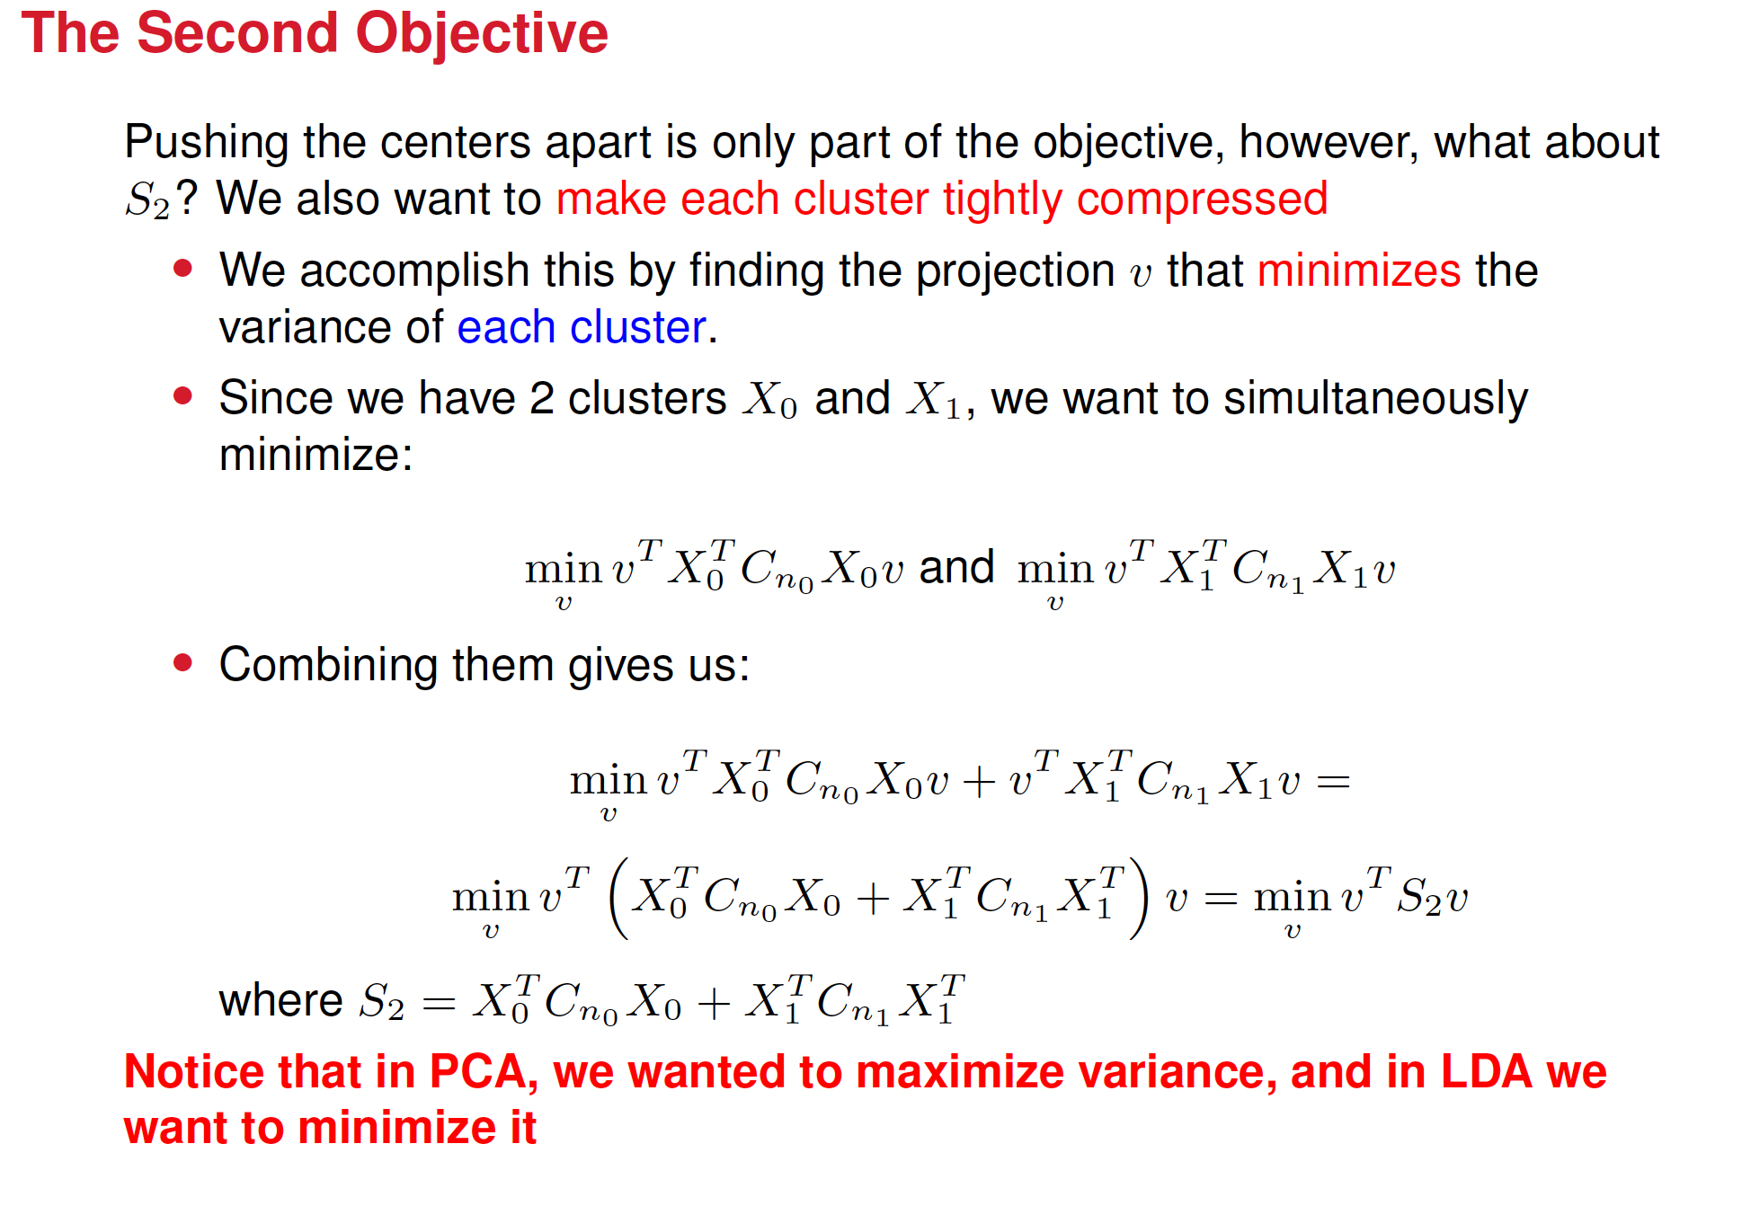
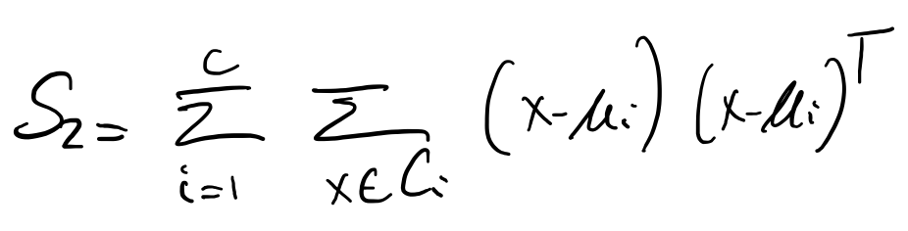

Slide 22








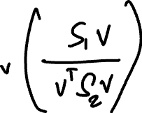

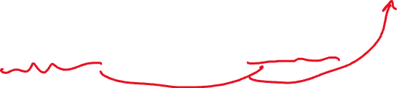
We want a direction $v$ where between-class scatter is large while within-class scatter is small.
We want $v^{T}S_{1}v$ to be large relative to $v^{T}S_{2}v$. The natural way to do this is to maximize the ration
The solution vector v is the optimal projection direction to achieve class separation.

Slide 23











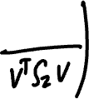

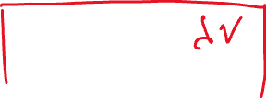














Now we apply the Lagrange multipliers

Slide 24
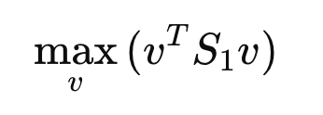
What Does This Mean in Words?

Slide 25
What Does This Mean in Words?
"Find the vector v that maximizes the value of the of v^{T}S1v"

